Slide 1
Rubik‘s Cube Solver
Mustafa Mahmoud 01131919
Marti Zach 01430672

Slide 2
Overview
Goal
Reconstruct constellation of Rubik‘s Cube
Appropriate representation
Feed into solver (or at least verify correctness)
Input
Ordinary webcam video stream or input video
Tools
Python
Image Processing and Computer Vision libraries (OpenCV)

Slide 3
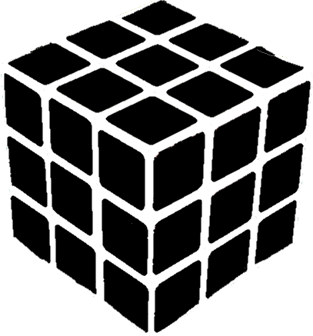
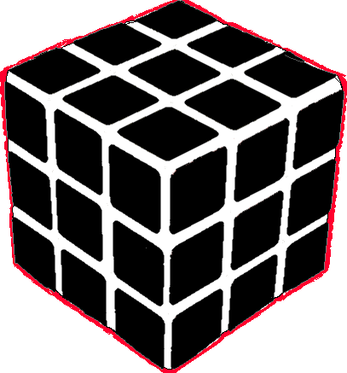
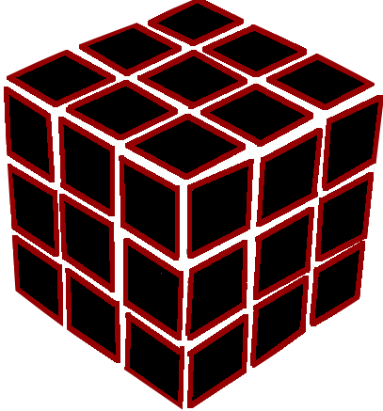
Object Models
Very explicit and well defined problem
1 cube, 6 faces, 9 facelets, 4 corners
Top Down
Bottom Up

Slide 4
Finding features
General envisioned pipeline
Noise Filtering, Grayscale Conversion, Edge Detector
Discriminate contours using different characteristics
Group facelets to faces, interpolate missing values
Alternatives
Region or point based segmentation
Implicit modeling
Top down approach
Hough transform, …
Edge based approach

Slide 5
Problems
Finding Contours
Reflections, occlusions
Discriminating between wanted and unwanted contours
Grouping Facelets
Stable mechanisms very hard to find (centroids, relative or absolute angles, line groupings)
Dealing with uncertainty
New result contradicting the other ones
Filter Parameters
Very much dependent on environment

Slide 6
In Depth: Finding,discriminating and grouping contours
Finding
All of them can never reliably be found
Hugely dependent of filter parameters (especially of edge detector)
Discriminating
Characteristics of all facelets
Same size, quadratic, uniform intensity values inside, not too big, not too small
Grouping
Characteristics of facelets on same face
Similar angles, pairwise similar alignment of lines
Projective geometry makes this a hard task

